Slide 1
Cleaning & aligning scans
DAY 08 OF 16 · 3D & 6DOF STREAMING
Real scans are noisy and come in pieces. Today we clean them and align them, and discover that alignment means finding a 6DoF pose.
Noise & outliers
Downsampling
Normals
Registration
ICP
Book: Ch. 5–6 · Code: day08_cleaning_registration/
Notes:
This session follows the preprocessing in the book’s Chapter 5 (downsampling, preprocessing) and Chapter 6 (3D data registration: coarse registration and ICP fine registration). The streaming link: ICP is the same family of algorithms headsets use to track their own pose.

Slide 2
Cleaning: less but better points
BOOK CH. 5–6 · PREPROCESSING
Voxel downsampling
Statistical outlier removal
Normals
Keep one point per small cube. Even density, fewer points (37k → 29k at 5 cm).
Fit a plane to each neighbourhood; its perpendicular is the normal. Needed for meshing, lighting and ICP.
Drop points whose mean neighbour distance is unusually large (2,000 fake outliers → 1,627 removed).
01
02
03
Day 08 · Cleaning & registration
2
Notes:
Explain each step with the numbers from the lab printout. Voxel downsampling evens out density, which matters because scanners produce dense data near the sensor and sparse data far away. Statistical outlier removal looks at the average distance to the 20 nearest neighbours and removes points more than 2 standard deviations away. Ask: what real-world things look like outliers? Reflections, dust, people walking past, flying pixels at depth edges. Normals come from PCA of the neighbourhood (more on Day 9).

Slide 3
Registration = find the pose that aligns two scans
BOOK CH. 6 · REGISTRATION
find R, t minimising Σ ‖ R·pᵢ + t − qᵢ ‖²
pᵢ
qᵢ
R, t
Points of the scan we move (source).
Matching points in the reference (target).
The 6DoF pose: exactly the matrix from Day 2.
Day 08 · Cleaning & registration
3
Notes:
The book calls registration unifying perspectives: bringing several scans into one frame. Stress that the unknown is a 6DoF pose. If correspondences pi to qi were known, the best R and t have a closed-form solution (via SVD). The hard part is that we do not know which point matches which. Coarse registration (features, manual points) gives a rough start; ICP refines it.

Slide 4

Iterative Closest Point in four repeated steps
BOOK CH. 6 · ICP
01
02
03
04
Match
Solve
Apply
Repeat
For each source point, take the closest target point (k-d tree!).
Compute the R, t that best aligns the matches.
Move the source by that pose.
Until the error stops falling.
Each step uses something from earlier sessions: k-d trees (Day 7), poses (Day 2), normals (today).
Day 08 · Cleaning & registration
4
Notes:
ICP alternates between guessing correspondences and solving for the pose. Point-to-point minimises distances between points; point-to-plane minimises the distance along the target normal and converges faster on flat surfaces. Our lab first used point-to-point and got stuck about 5 to 10 cm off on this symmetric house; point-to-plane recovered the pose exactly. That is a good story to tell: the method matters. ICP needs a good initial guess: Lab L4 measures when it fails.

Slide 5
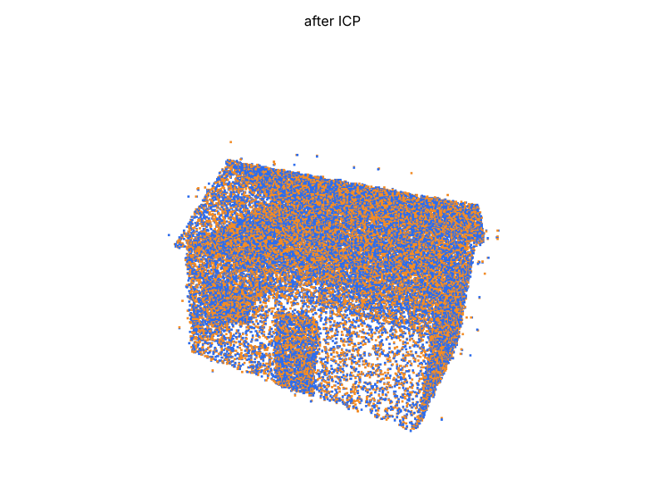
ICP recovers a secret 6DoF pose
LAB RESULT
■ Before: overlap 0.56, RMSE 0.167 m
■ After: overlap 1.00, RMSE 0.017 m
■ Point-to-point got stuck; point-to-plane did not
■ Same idea tracks headsets and robots (SLAM)
Secret pose: 12° yaw, 3° pitch, −2° roll, (0.8, −0.5, 0.2) m. Point-to-plane ICP error: 0.0 cm and 0.00°.
Day 08 · Cleaning & registration
5
Notes:
The script moves the scan by a known pose and asks ICP to find it. Before ICP the fitness (overlap) is 0.56 and RMSE 0.167 m; after, fitness 1.0 and RMSE 0.017 m, which is the noise level we added. The recovered matrix matches the secret one. Then make the link: an AR headset or robot does this every frame between what its sensors see now and its map, and the result is its own 6DoF pose. Visual-inertial odometry and SLAM are the names to mention.

Slide 6
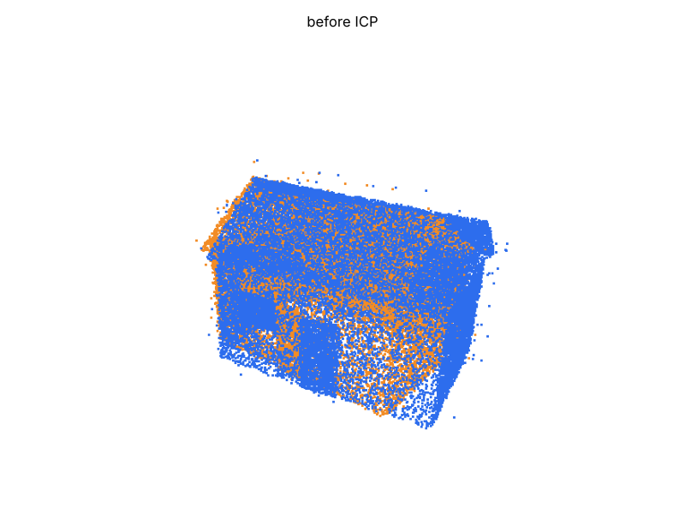
Clean a noisy scan and find the hidden pose
HANDS-ON LAB · COPY, RUN, LOOK
RUN IT
cd day08_cleaning_registration
python clean_and_register.py
→ Four windows: raw, cleaned, before ICP, after ICP.
→ Compare the secret and recovered matrices.
→ Switch to PointToPoint and rerun.
Day 08 · Cleaning & registration
6
Notes:
Run and look at all four windows. Exercises: change PointToPlane to PointToPoint and compare; increase the secret rotation to 45 degrees and see ICP fail; change std_ratio. Lab L4 question 3 is a systematic version of this. 30 minutes.

Slide 7
Three things to remember
1
Downsample and remove outliers before anything else.
2
Registration finds the 6DoF pose that aligns two scans.
3
ICP = match closest points, solve the pose, repeat. It needs a good first guess.
BEFORE NEXT SESSION
Finish Lab L4. Next: from geometry to meaning.
Day 08 · Cleaning & registration
7
Notes:
Recap and preview Day 9, where we teach the computer what the points are: ground, walls, trees, objects.

